Slide 1
Regression Analysis
Other Regression Methods
Nicoleta Serban, Ph.D.
Associate Professor
Stewart School of Industrial and Systems Engineering
Weighted Least Squares Regression

Slide 2
About this lesson

Slide 3
Multiple Linear Regression
Data: {(x₁₁,.., x_{1p}),Y₁},….,{(x_{n1},.., x_{np} ),Y_{n}}
Model: Y_{i} = β₀ + β₁x_{i1} + β₂x_{i2} +…+ β_{p}x_{ip} + ε_{i}, i =1,…,n
What if the variance is not constant?
Transform the response variable using a variance-stabilizing transformation
Weighted Least Squares Regression
Assumptions:
Linearity/Mean Zero Assumption: E(ε_{i}) = 0
Constant Variance Assumption: Var(ε_{i}) = σ²
Independence Assumption: {ε₁,…, ε_{n}} are independent random variables
Normality Assumption: ε_{i} ~ Normal

Slide 4
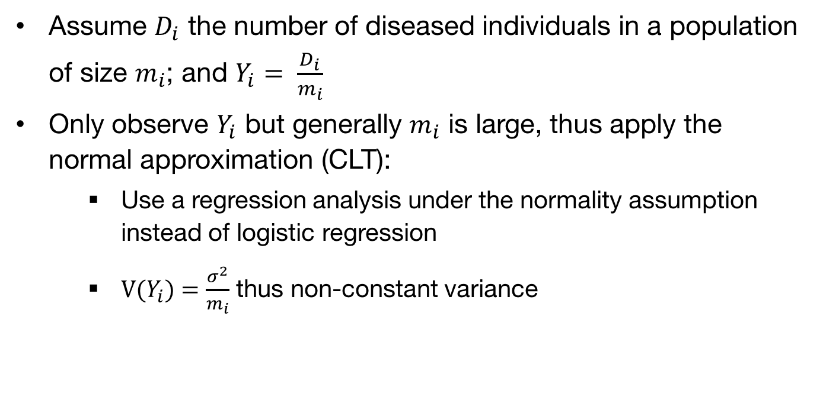
Example: Normal Approximation
Assume $D_{i}$ the number of diseased individuals in a population of size $m_{i}$; and $Y_{i}= \frac{D_{i}}{m_{i}}$
Only observe $Y_{i}$ but generally $m_{i}$ is large, thus apply the normal approximation (CLT):
  Use a regression analysis under the normality assumption instead of logistic regression
  V($Y_{i}$) = $\frac{σ^{2}}{m_{i}}$ thus non-constant variance

Slide 5
Weighted Least Regression (WLS)
Data: {(x₁₁,.., x_{1p}),Y₁},….,{(x_{n1},.., x_{np} ),Y_{n}}
Model: Y_{i} = β₀ + β₁x_{i1} + β₂x_{i2} +…+ β_{p}x_{ip} + ε_{i}, i =1,…,n
Assumptions: For the vector of errors ε = (ε₁,..., ε_{n})
Linearity/Mean Zero Assumption: E(ε) = 0
Covariance-Variance Assumption: V(ε) = Σ
Independence Assumption: {ε₁,…, ε_{n}} are independent random variables if Σ is a diagonal matrix
Normality Assumption: ε ~ Normal

Slide 6
Parameter Estimation (β₀,β₁,β₂,…,β_{p})
To estimate (β₀,β₁,β₂,…,β_{p}) , we find values that minimize squared error:
Statistical Properties:
Upshot: The covariance-variance matrix of the error terms is assumed known. However, it is needed for statistical inference. How to get Σ?
Notes:
Why n-p-1? Examination question.

Slide 7
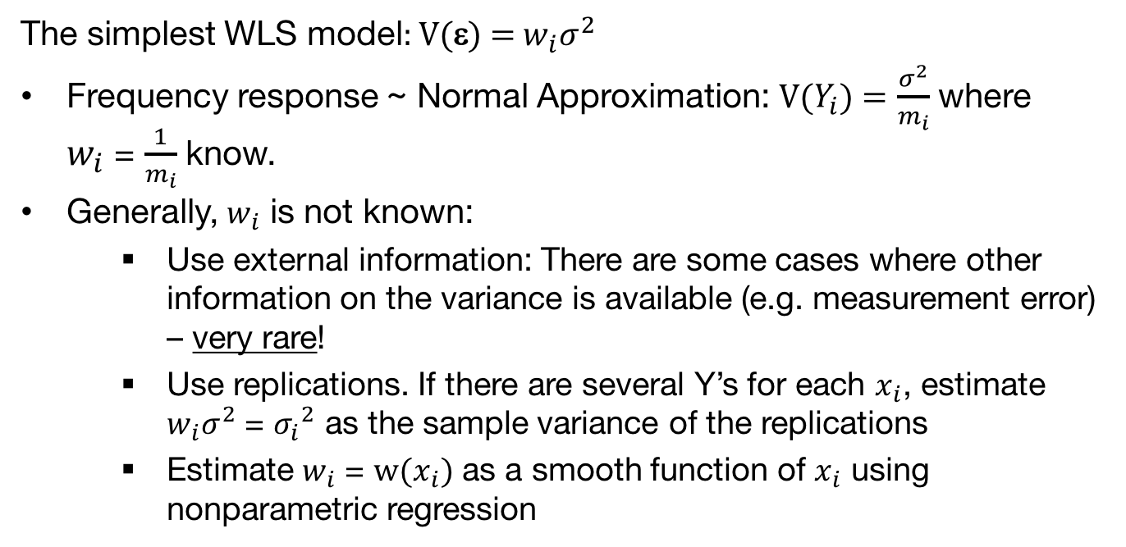
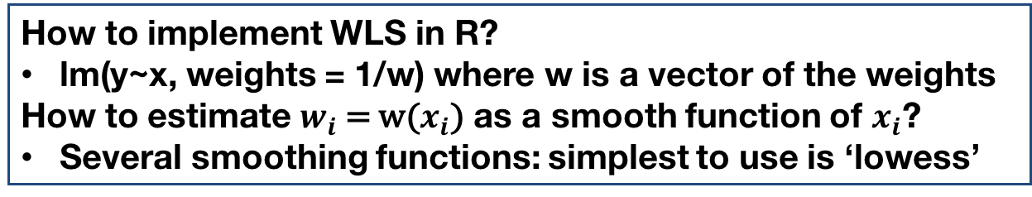
Simple WLS
The simplest WLS model: V(ε) = $w_{i}σ^{2}$
Frequency response ~ Normal Approximation: V($Y_{i}$) = $\frac{σ^{2}}{m_{i}}$ where
$w_{i}$ = $\frac{1}{m_{i}}$ know.
Generally, $w_{i}$ is not known:
  Use external information: There are some cases where other information on the variance is available (e.g. measurement error) – very rare!
  Use replications. If there are several Y’s for each $x_{i}$, estimate $w_{i}σ^{2}$ = ${σ_{i}}^{2}$ as the sample variance of the replications
  Estimate $w_{i}$ = w($x_{i}$) as a smooth function of $x_{i}$ using nonparametric regression
How to implement WLS in R?
lm(y~x, weights = 1/w) where w is a vector of the weights
How to estimate $w_{i}$ = w($x_{i}$) as a smooth function of $x_{i}$?
Several smoothing functions: simplest to use is ‘lowess’

Slide 8
Summary

